Slide 1

On Traitors of Truth, Merchants of Doubt
Gerben ter Riet, MD PhD
Faculty of Health, Sport & Exercise
Amsterdam University Applied Sciences
orcid.org/0000-0002-2231-7637

Slide 2
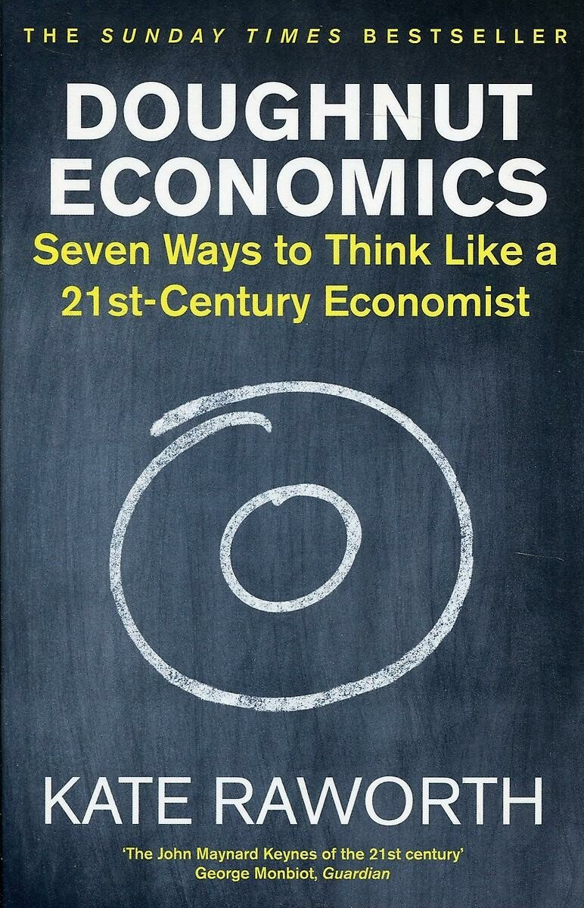


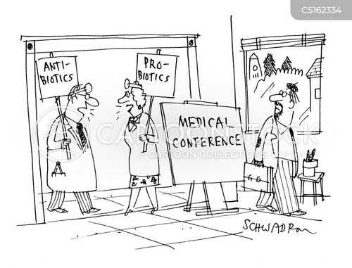

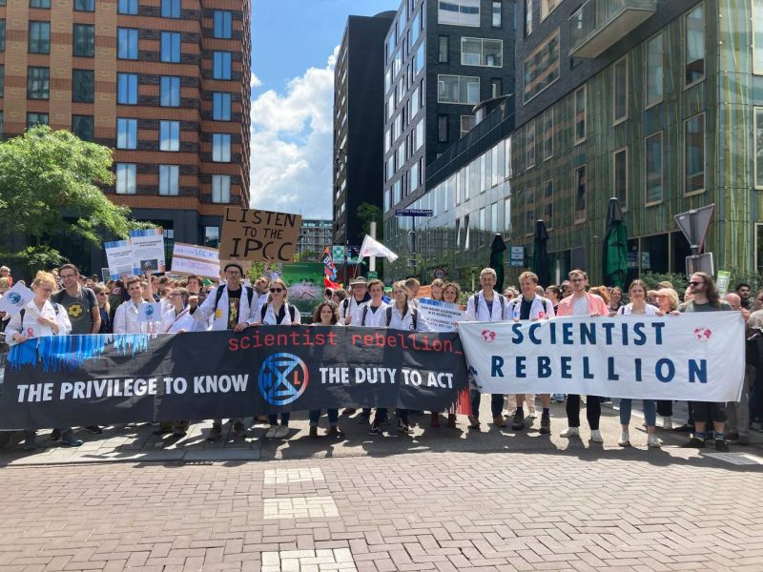


Conflicts of interest I
Notes:
Roche, Marriott, Zambon, Elsevier

Slide 3

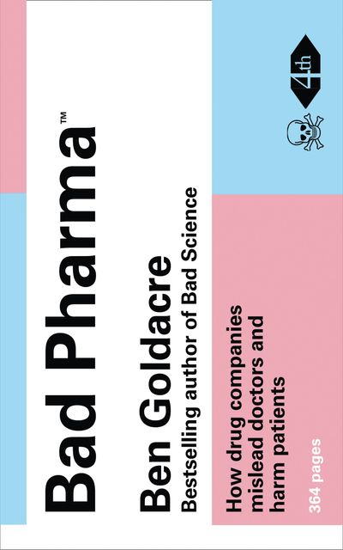
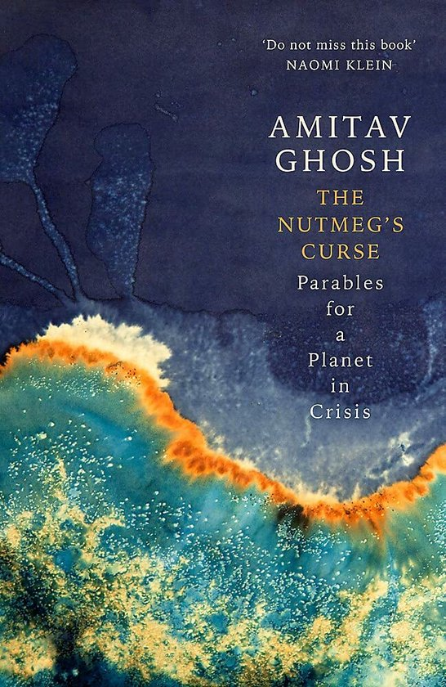


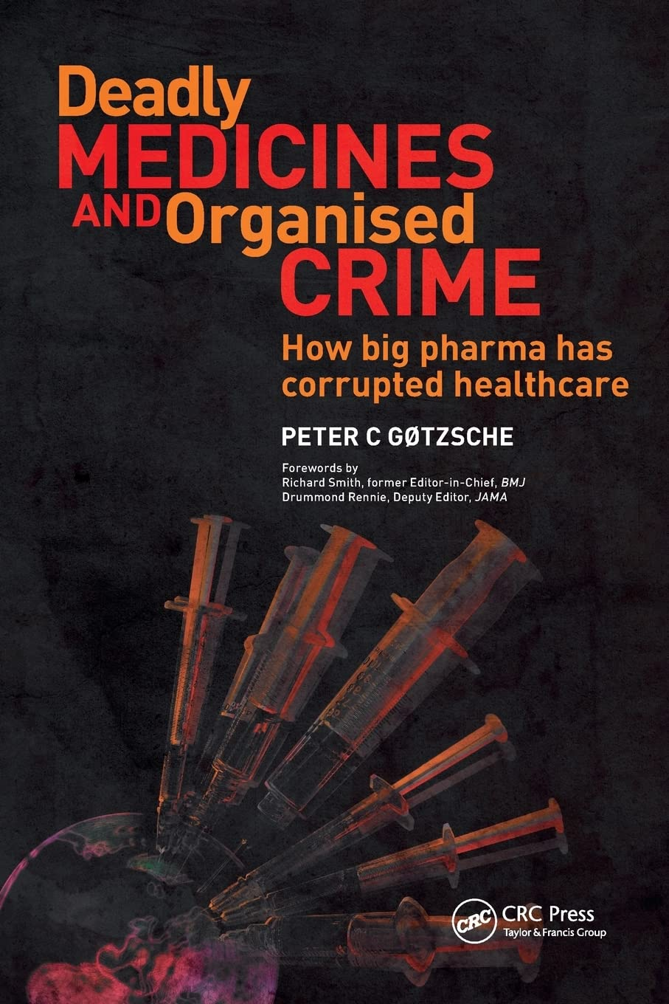
Conflicts of interest II

Slide 4



Slide 5
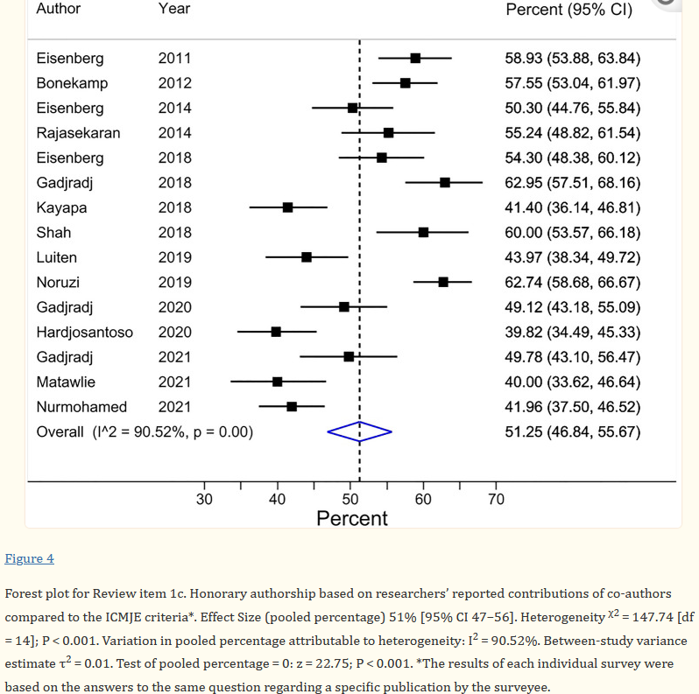
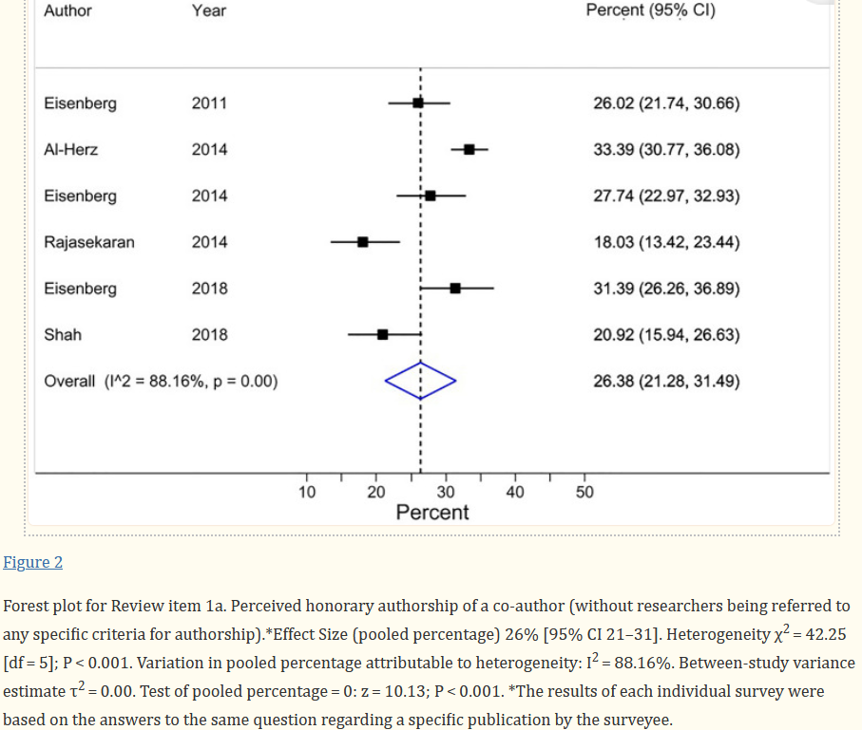
Honorary authorship is highly prevalent in health sciences: systematic review and meta-analysis of surveys
Notes:
https://www.ncbi.nlm.nih.gov/pmc/articles/PMC10883936/
HA based on researchers’ reported contributions of co-authors compared to the ICMJE criteria. (Review item 1c)
A pooled average of 51% (95% CI 47–56, based on 15 surveys and 5111 respondents) of HA was found when researchers were asked to declare their co-author(s’) contributions on the publication at issue (and those were then compared to ICMJE criteria by the researchers conducting the survey)
Perceived HA of a co-author (without researchers being referred to any specific criteria for authorship). (Review item 1a)
A pooled average of 26% [95% CI 21–31] of researchers (based on data from 6 surveys, and a total of 2,758 respondents) perceived that at least one of their co-author(s) on the publication at issue had not contributed sufficiently to deserve authorship (Table ​(Table3)3) (Fig. 2). These judgments were self-perceived and not based on pre-defined criteria for authorship.

Slide 6
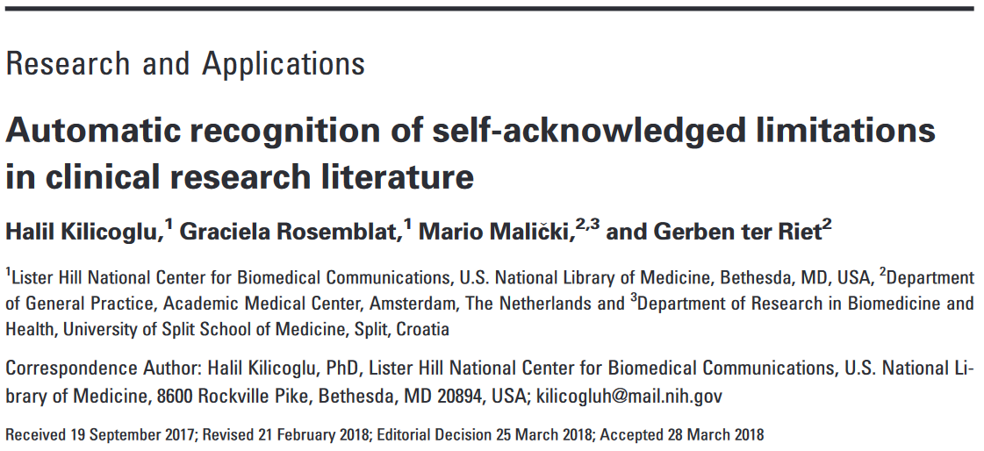
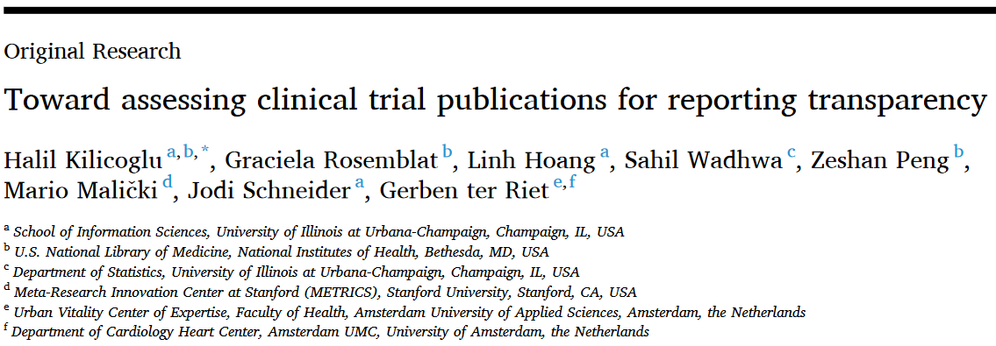
Some work I collaborated on: transparency and acknowledging limitations

Slide 7
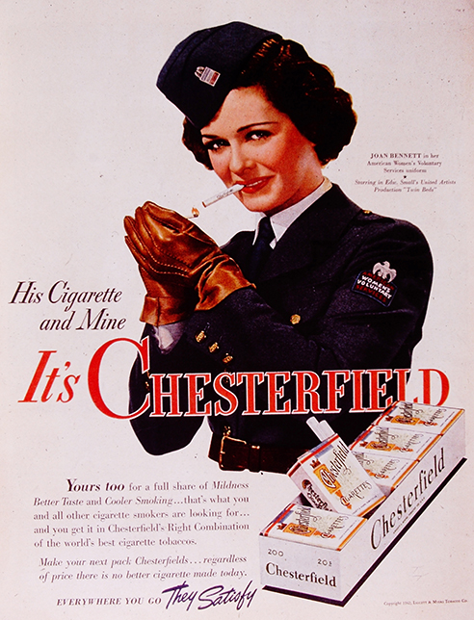
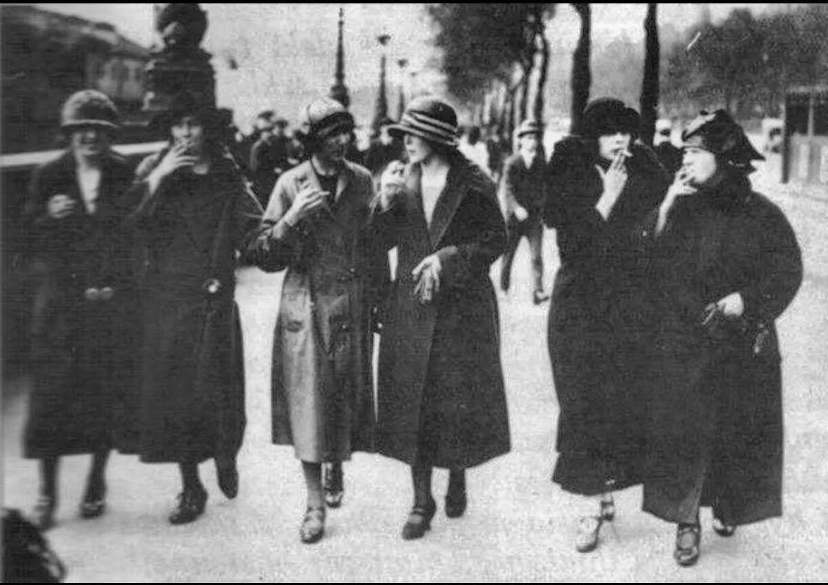

Edward Bernays: “We are governed, our minds are molded, our tastes formed, our ideas suggested, largely by men we have never heard of."

Slide 8
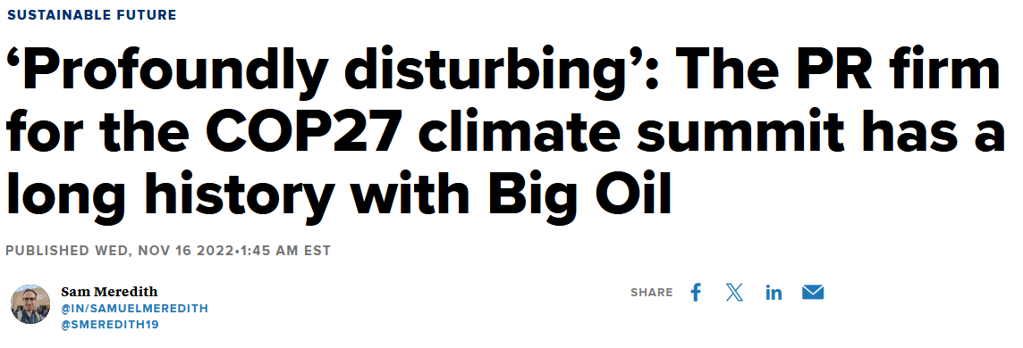

Slide 9
Delay regulation: Tens of millions of life years lost
Robert K. Merton (1942, CUDOS):
OS = organized skepticism, questioning assumptions, evidence, and conclusions before accepting them as valid.
John Hill (CEO Hill & Knowlton, 15-12-1953) Consulting the US tobacco industry:
“Scientific doubts must remain.”
Notes:
https://www.bol.com/nl/nl/p/merchants-of-doubt/1001004010952535/?Referrer=ADVNLGOO002008O-S--&gad_source=1&gclid=Cj0KCQjwgL-3BhDnARIsAL6KZ6-W-gYl0TSI4kwcU3idwrYMz8V0Xz84Jz7EGgTx-EXrv5yFzkXIAPcaAls7EALw_wcB
https://en.wikipedia.org/wiki/Mertonian_norms

Slide 10

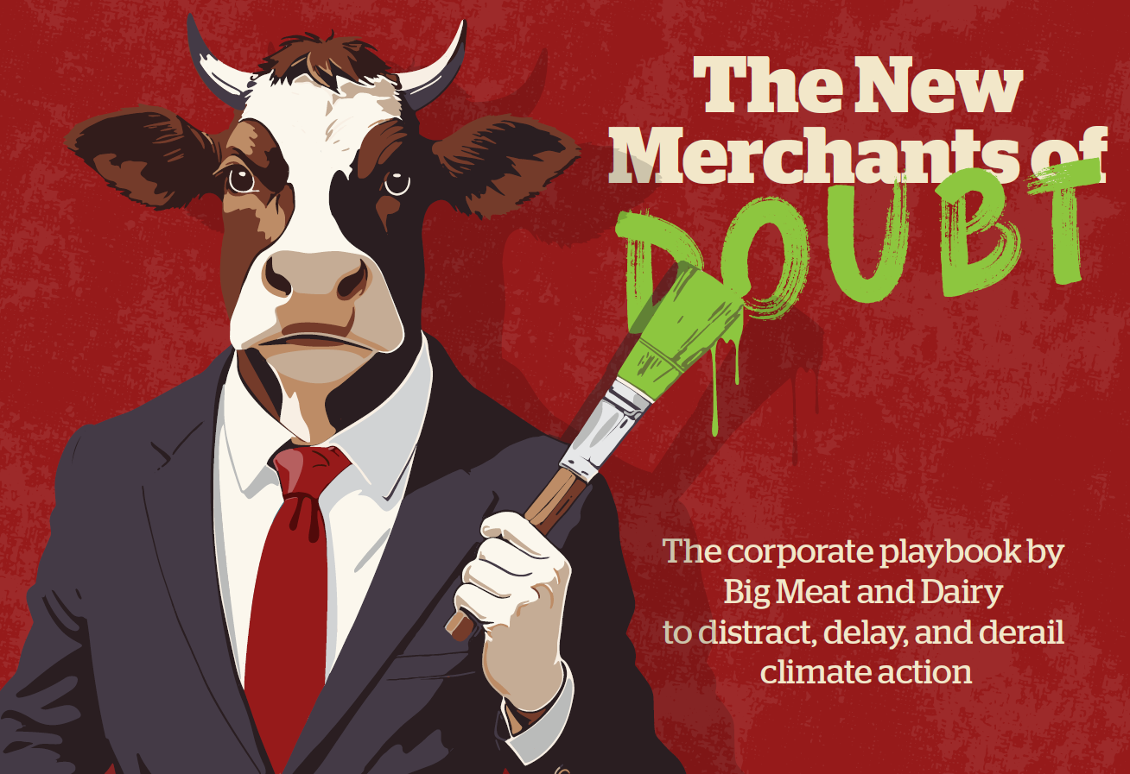
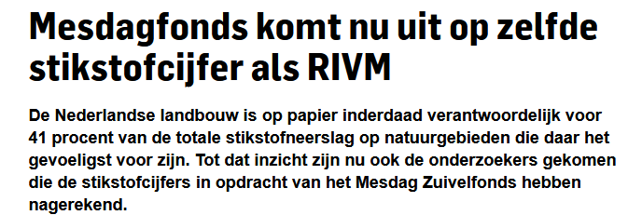
Notes:
nrc-krant-20240907-5669639-hoe-trumps-wereld-invloed-kreeg-op-het-nederlandse-stikstofbeleid-1
Elisabeth Bik on METRICS talk, slide 11:21 min
EB: “My message could be used to discredit science as a whole.”

Slide 11
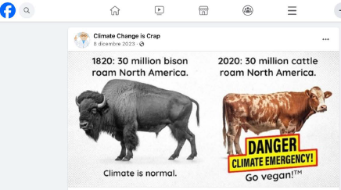
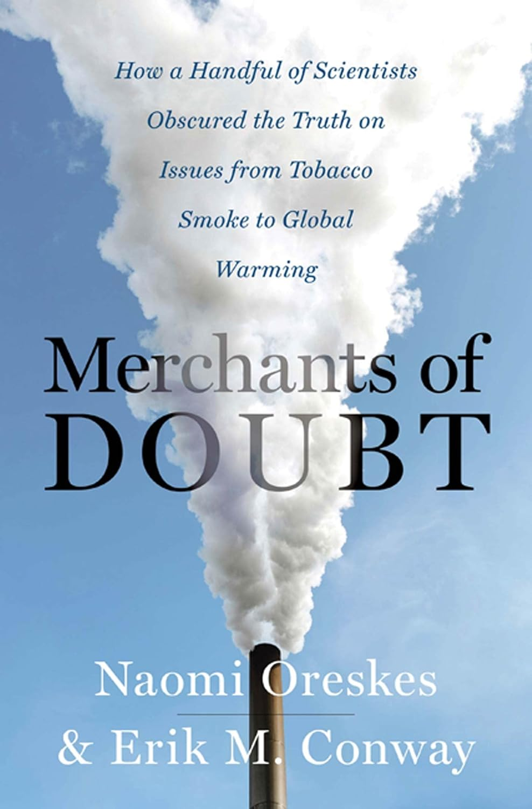
New Merchants of Doubt
Tobacco – Strategic Defense Initiative (‘Star Wars’) – Acid Rain – Ozone – Secondhand Smoking - Global Warming – Rachel Carson (‘Silent Spring’ (1962))
Notes:
https://en.wikipedia.org/wiki/Merchants_of_Doubt
Journalism: equal time principle, both sideism
https://changingmarkets.org/report/the-new-merchants-of-doubt-how-big-meat-and-dairy-avoid-climate-action/
While arguments comparing cows with bison have become a prominent way of casting doubt on the need to reduce livestock, these arguments rely on numerous factual inaccuracies. The
first comes down to population numbers. While there is no concrete data on historical bison populations, most estimates put them between 30 and 60 million in North America.227 In contrast, there are about 90 million cattle in the United States, according to recent data from the Department of Agriculture (USDA).228
The second reason modern livestock are a significant source of methane compared with bison is due to how much they eat. While experts say both animals generate around the same amount
of methane per kilogram of food, their food intake differs significantly. According to figures from the Texas Parks and Wildlife Department, bison eat 1.6% of their body mass per day – or about 24 pounds for a 1,500-pound animal.229 In comparison, some dairy cows eat as much as 100 pounds of food per day, according to USDA figures, which is around 6.6% of a 1,500-pound animal.230 ,231

Slide 12
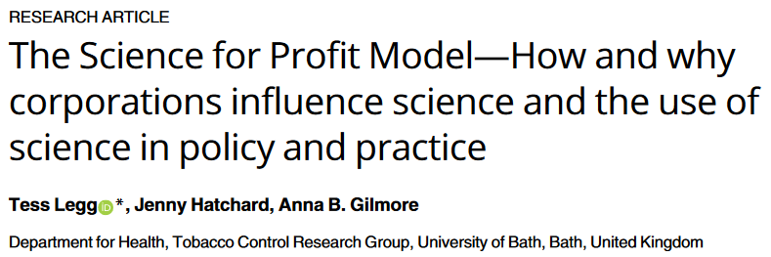
Macro Strategies
Influence the conduct and publication of science; skew evidence bases
Undermine unfavorable science, create a distorted picture of the evidence base
Create an “echo chamber” for industry’s scientific messaging
Create industry-friendly policymaking environments which shape the use of science in policy-making
Manufacture trust in industry and its scientific messaging
Notes:
https://pubmed.ncbi.nlm.nih.gov/34161371/

Slide 13

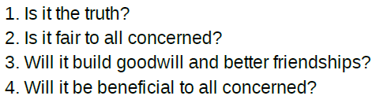
Eight industries covered
Tobacco | Pharma
Alcohol | Fossil fuels
Food and drink | Extractive
Chemicals/ manufacturing | Gambling

Slide 14
Corporate strategy | Examples
5.1. Manufacture a picture of industry credibility | Normalise industry’s presence in academic settings in attempts to gain trust and scientific credibility; Use recruitment and funding of scientific experts to enhance industry credibility; Fund academics, students, patient associations, infrastructure; Inflate the scientific credibility of industry science, scientists, and scientific perspectives
5.2. Conceal industry’s involvement in science, scientific messaging and influence on policy reforms | Create or fund 3rd party organisations (using names which sound independent) to produce science, e.g. Institute for Biological Research, Center for Indoor Air Research, American Enterprise Institute; Ghost-write studies or use ghost-writing companies to do so and publish the work using prestigious “guest authors”; Fund letters to the editor without disclosing financial conflicts of interest
Notes:
1.1. refers to macro strategy 1 and meso strategy 1 etc. The examples are micro strategies (https://pubmed.ncbi.nlm.nih.gov/34161371/)
https://www.rivm.nl/nieuws/reactie-rivm-op-kritiek-mesdag-zuivelfonds
https://www.mesdag-fonds.nl/nieuws/143/-bug-in-rekenmodel-ops-oorzaak-onjuist-stikstofcijfer.html

Slide 15
5.2. Fund 3rd parties to amplify or shape their scientific stances
A 1978 manual for industries facing regulation, for instance, advised “co-opting” academics and “identifying the leading experts in each relevant field and hiring them as consultants or advisors, or giving them research grants and the like…it must not be too blatant, for the experts themselves must not recognize that they have lost their objectivity…” (Franta, 2022; Owen & Braeutigam, 1978).4

Slide 16
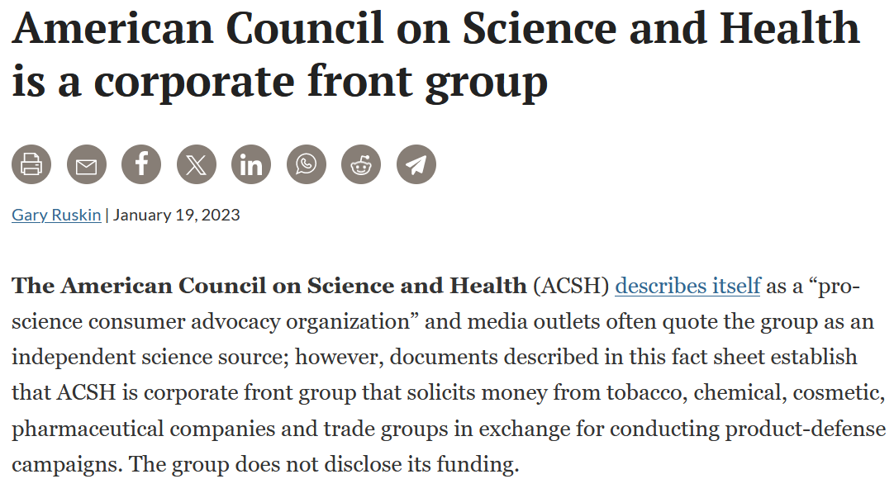
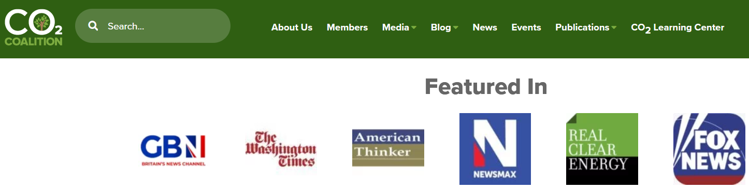
3.2. Create front groups to amplify industry-friendly scientific messages
Notes:
https://usrtk.org/industry-pr/american-council-on-science-and-health/
https://academicinfluence.com/inflection/study-guides/influential-think-tanks
https://en.wikipedia.org/wiki/CO2_Coalition

Slide 17
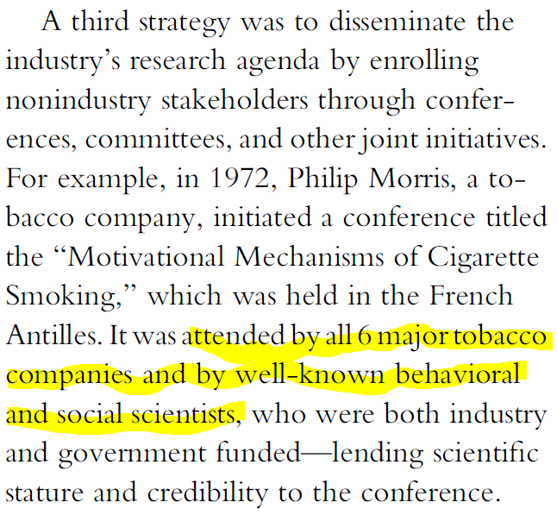
3.3. Use education, events, and meetings to disseminate industry-favorable scientific messages

Slide 18
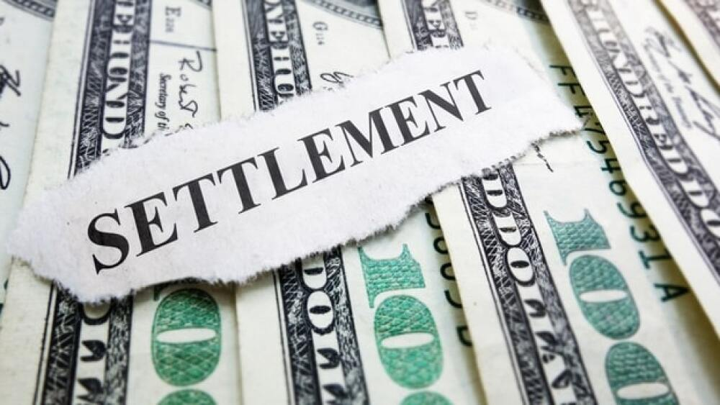
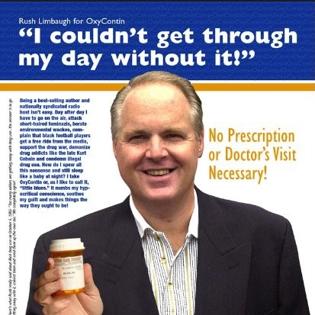
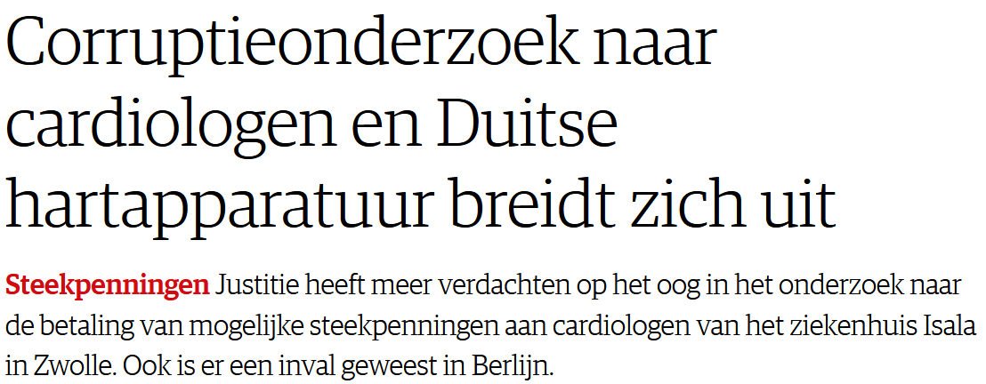
Purdue, Biotronik

Slide 19
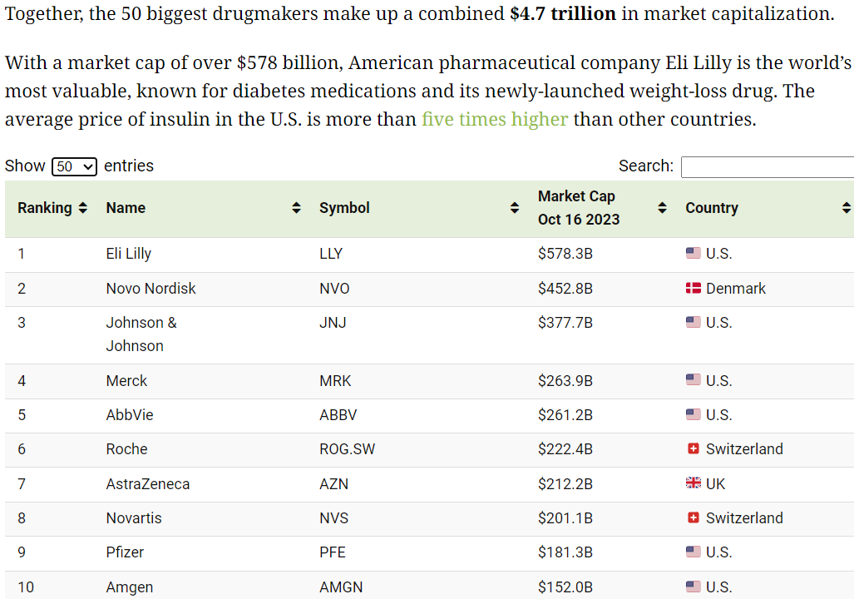
Market Value of Top 10 pharma giants
Notes:
The World's 50 Largest Pharmaceutical Companies (visualcapitalist.com) accessed on 22 Sep 2024
Top 10 pharma settlements since 2018 | Fierce Pharma accessed on 22 Sep 2024
https://apnews.com/article/supreme-court-purdue-pharma-opioid-crisis-bankruptcy-9859e83721f74f726ec16b6e07101c7c# [Updated 10:39 PM GMT+2, June 27, 2024]

Slide 20
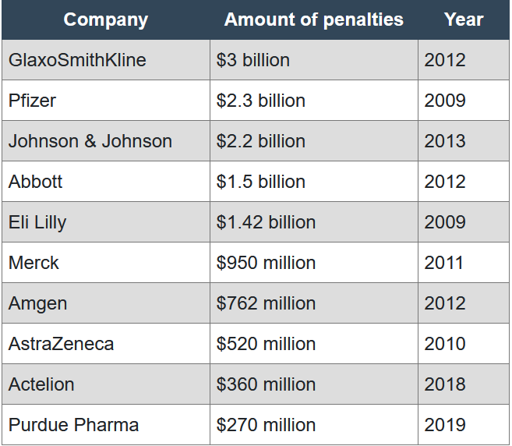
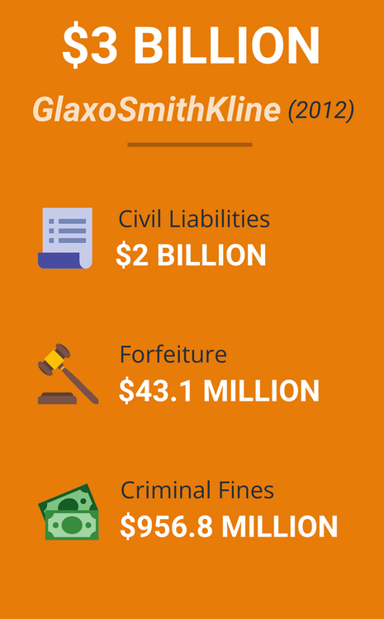

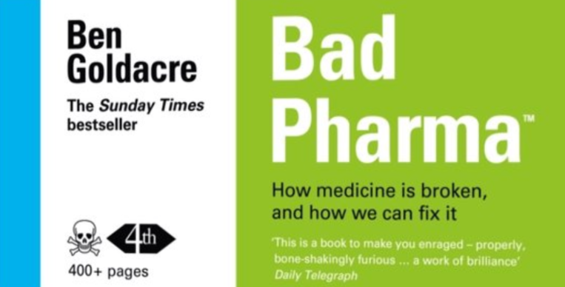
System flaw?: Fox guarding the henhouse
Notes:
A system in which government pays for research into effectiveness and safety of new drugs could not exist? A flood of products would stifle it.
A drug company paid several millions for forfeiture, a fine. What does that mean? What did they do wrong? It typically means they have settled allegations of misconduct or violations of laws and regulations. The misconduct could relate to a variety of issues, including but not limited to:
1. Quality and Safety Violations:
Example: Failing to maintain adequate standards of quality and safety, leading to the distribution of contaminated or defective products.
2. Marketing and Promotion:
Example: Engaging in off-label marketing, or promoting drugs for uses that have not been approved by regulatory agencies such as the FDA (U.S. Food and Drug Administration).
3. Pricing and Billing:
Example: Overcharging government healthcare programs or patients, or engaging in price fixing.
4. Research and Development:
Example: Falsifying data or failing to disclose safety information during the drug approval process.
5. Manufacturing Practices:
Example: Violating Good Manufacturing Practices (GMP) regulations, resulting in substandard product quality.
6. Environmental Concerns:
Example: Improper disposal of waste or chemicals, causing environmental damage.
In these cases, the drug company may agree to pay a significant sum of money to settle the allegations without admitting guilt. These settlements often include a financial penalty intended to deter future misconduct and, in some cases, may require the company to implement corrective actions to address the underlying issues.
These fines can be imposed by various regulatory bodies depending on the country and the nature of the violation. In the United States, for example, the FDA, DOJ (Department of Justice), and EPA (Environmental Protection Agency) are among the entities that can impose such
and what about civil liabilities? What is meant by that in the case of drugs development?
Civil liabilities in the context of drug development refer to the legal responsibilities and consequences a pharmaceutical company faces in civil court, as opposed to criminal court. These can arise due to various reasons like manufacturing defects, inadequate warnings, design defects, or other issues leading to injury or harm. Here are some common scenarios:
1. Product Liability:
Example: If a drug causes unforeseen side effects or harms to patients, the company might face lawsuits for medical expenses, pain and suffering, lost wages, or other damages. The company is held liable for selling a defective or dangerous product.
2. Negligence:
Example: If the company failed to exercise reasonable care in the design, manufacturing, or distribution of the drug, and that failure resulted in harm.
3. Failure to Warn:
Example: If a drug company did not provide adequate warnings or instructions about the risks associated with the drug, and patients suffered as a result.
4. Fraudulent Misrepresentation:
Example: If a company falsely advertises or represents its drugs, causing harm or financial loss to patients or other stakeholders.
Financial Implications:
Pharmaceutical companies might need to compensate victims or pay punitive damages. They might also agree to settlements to resolve a multitude of lawsuits.
Operational Implications:
They might need to revise their warning labels, improve testing protocols, or even withdraw the drug from the market.
Reputation Implications:
The revelation of civil liabilities can damage the reputation of the drug company, affecting its stock price, customer trust, and future business.
These civil liabilities aim to compensate the victims and hold companies accountable for the safety and efficacy of their products. The civil liability cases are typically handled in civil courts and revolve around compensating victims rather than punishing the offenders (which is a focus in criminal cases).
These issues underscore the importance of rigorous clinical testing, ethical marketing, and thorough post-marketing surveillance to identify and mitigate risks associated with pharmaceuticals.

Slide 21
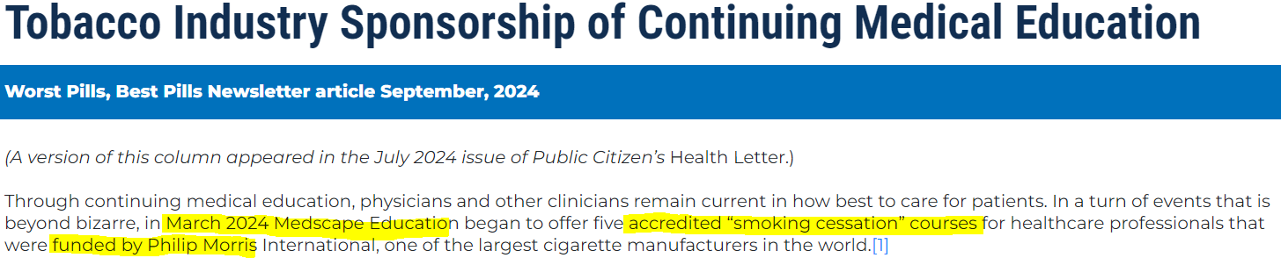
CME
Notes:
Newsletters (worstpills.org) accessed on 17 Sep 2024

Slide 22
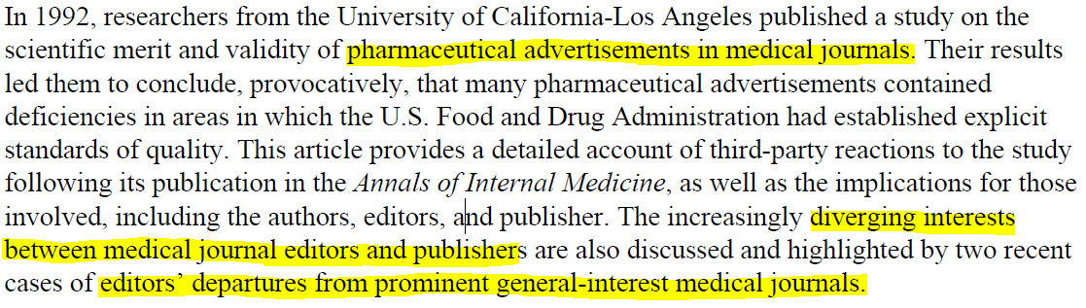
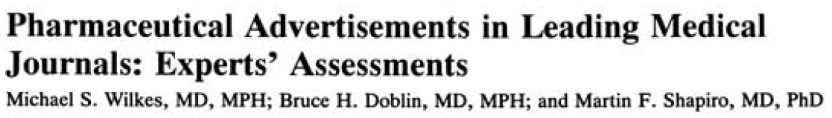
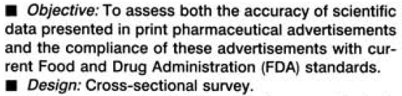
CONFLICTS BETWEEN COMMERCIAL AND SCIENTIFIC INTERESTS IN PHARMACEUTICAL ADVERTISING FOR MEDICAL JOURNALS
Notes:
https://www.acpjournals.org/doi/10.7326/0003-4819-116-11-912
CONFLICTS BETWEEN COMMERCIAL AND SCIENTIFIC INTERESTS IN PHARMACEUTICAL ADVERTISING FOR MEDICAL JOURNALS on JSTOR

Slide 23
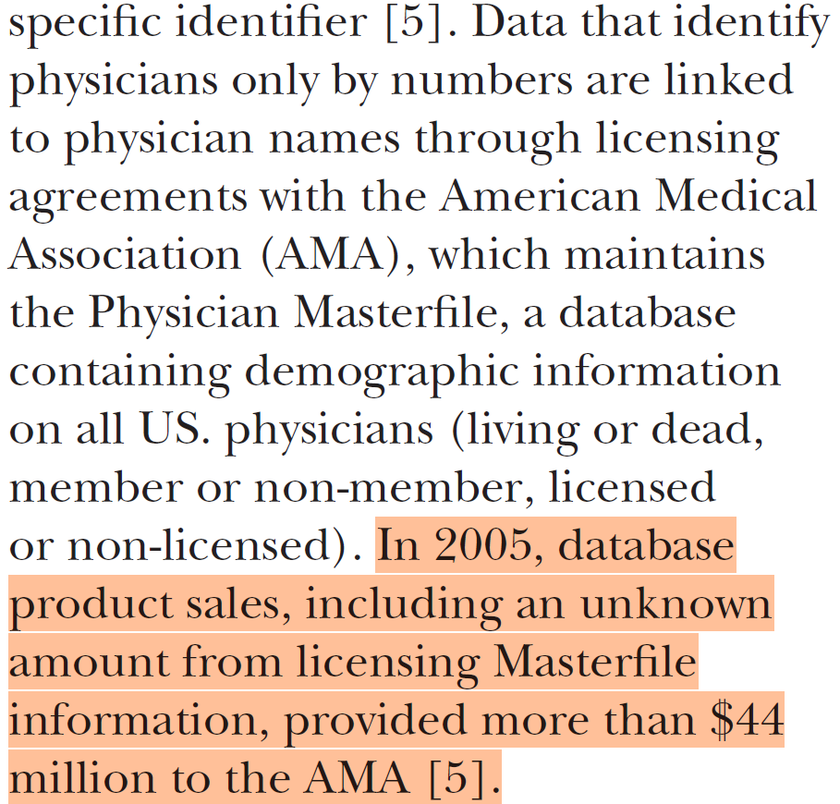
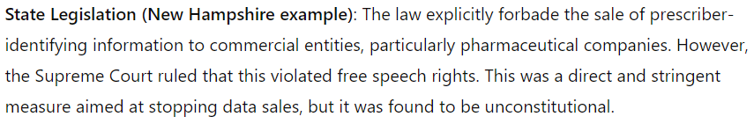
Am Medical Assoc: Critical Editor, complicit Association

Slide 24
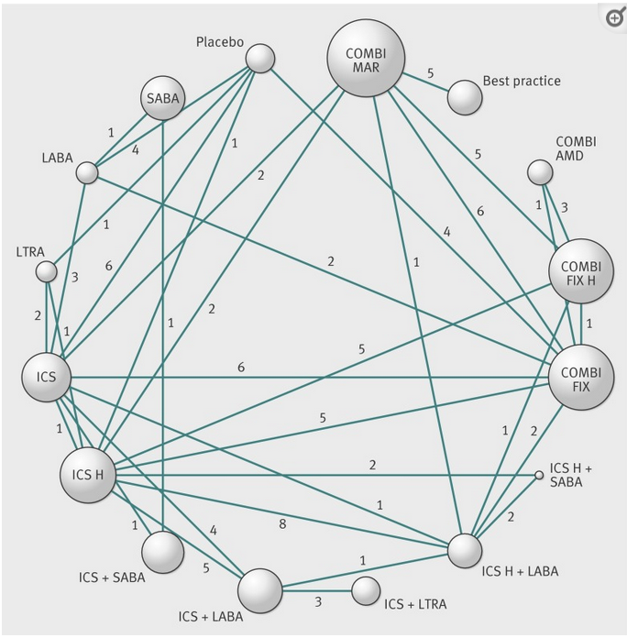
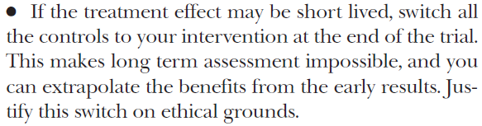
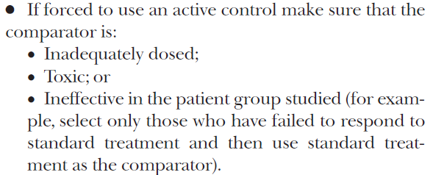
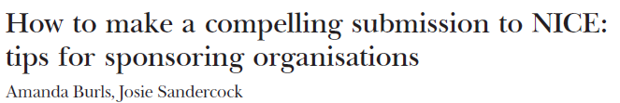
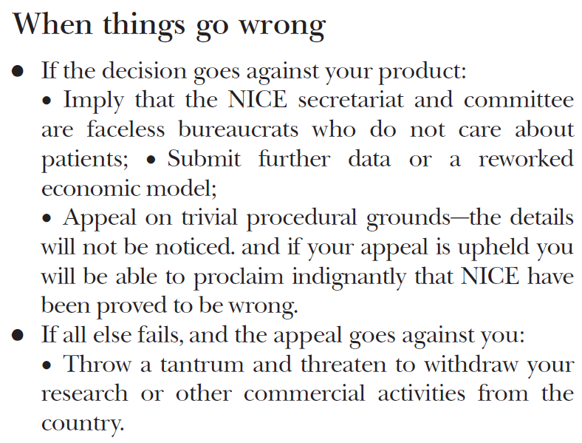
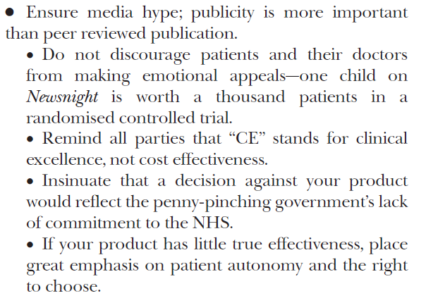
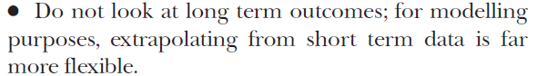
Dubious techniques to make your technology look effective
Notes:
Burls A, Sandercock J. How to make a compelling submission to NICE: tips for sponsoring organisations. BMJ. 2003 Dec 20;327(7429):1446-8. doi: 10.1136/bmj.327.7429.1446. PMID: 14684641; PMCID: PMC300798.
Loymans RJ, Gemperli A, Cohen J, Rubinstein SM, Sterk PJ, Reddel HK, Jüni P, ter Riet G. Comparative effectiveness of long term drug treatment strategies to prevent asthma exacerbations: network meta-analysis. BMJ. 2014 May 13;348:g3009. doi: 10.1136/bmj.g3009. PMID: 24919052; PMCID: PMC4019015.
Although the following “advice” is based on real examples of submissions to NICE, it should be remembered that similar biases can be found in academic, peer reviewed publications and that such practices are not the preserve of industry.

Slide 25
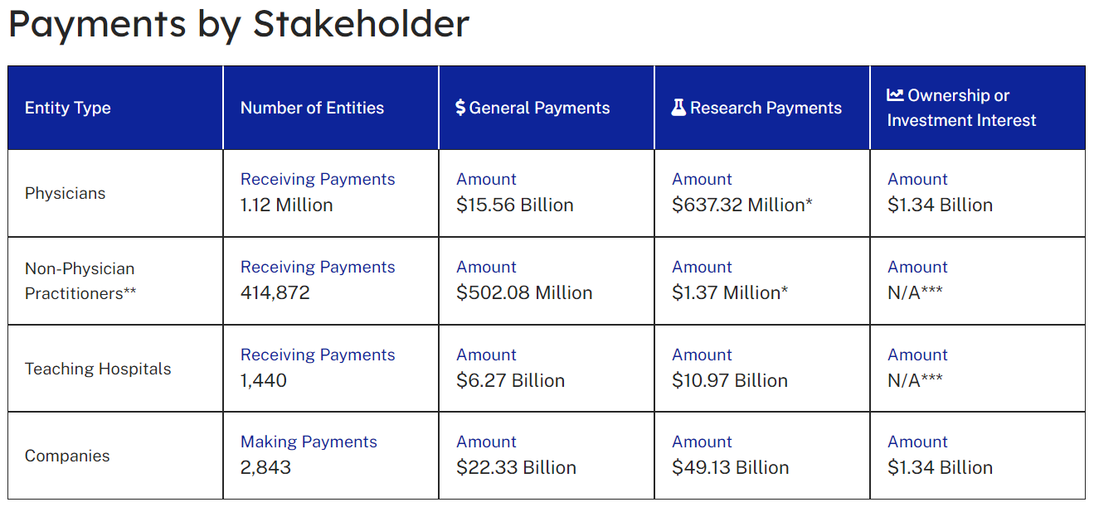
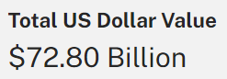
USA: Open payments (Sunshine act)
2017-2023
Notes:
OpenPayment Facts | OpenPayments (cms.gov), accessed on 17 Sep 2024

Slide 26
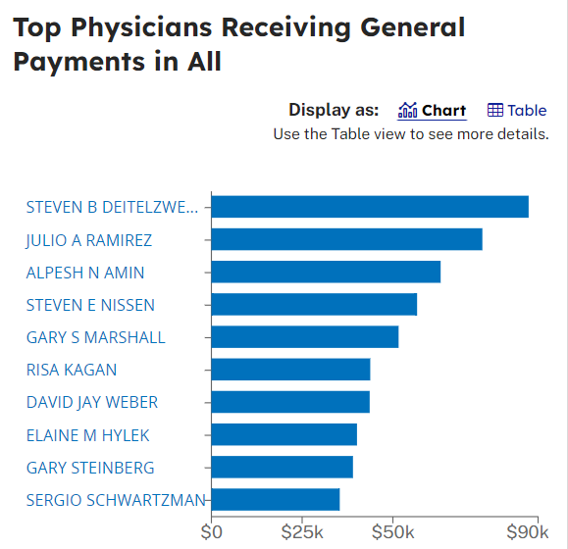
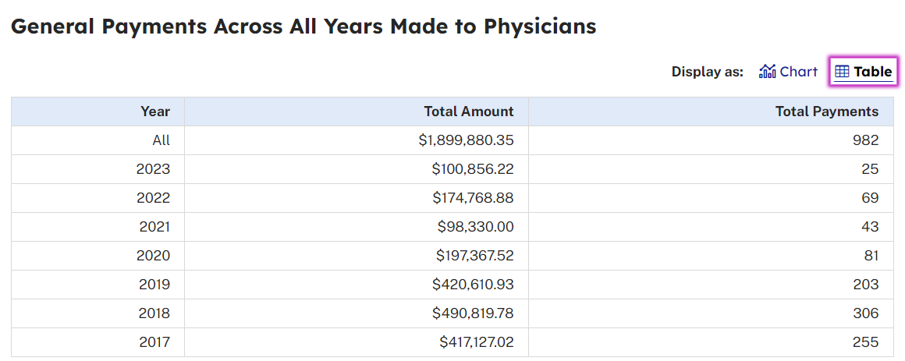
Open Payments (Sunshine)

Slide 27
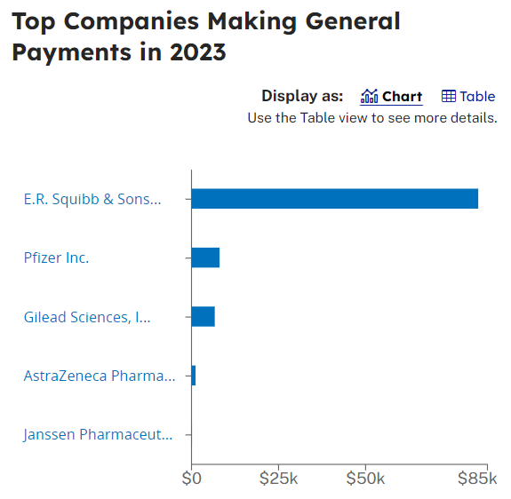
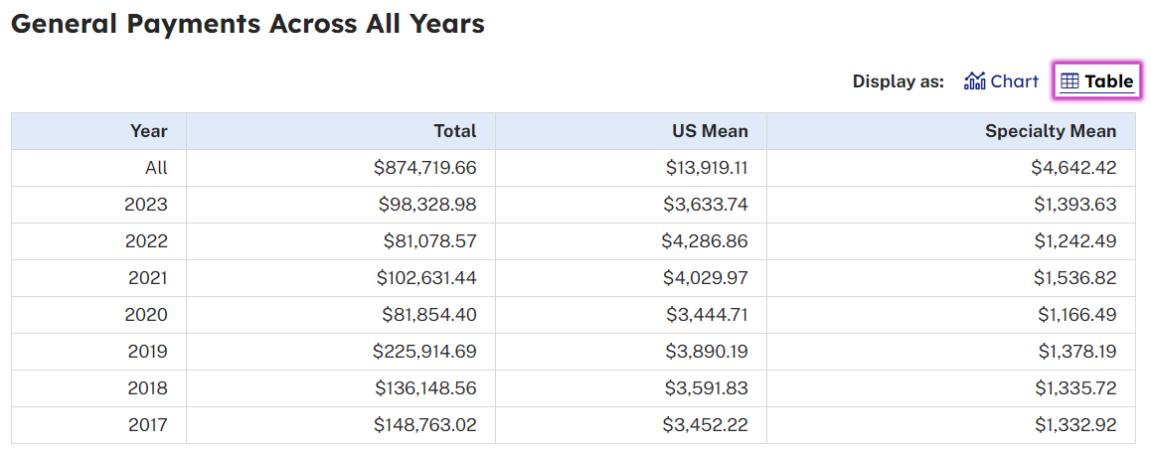
Dr. Steven Deitelzweig

Slide 28
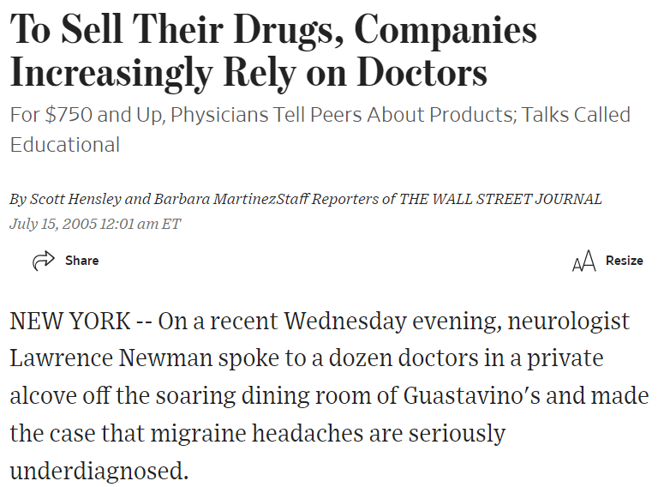
Food, Flattery, Friendship
Marketing whores
Drug whores
Product champions
Notes:
To Sell Their Drugs, Companies Increasingly Rely on Doctors – WSJ
Liste over personer der modtager økonomisk støtte eller har tilknytning til virksomheder (laegemiddelstyrelsen.dk)
88F92DB0DB084818BA2301D3B9C0796A.ashx (laegemiddelstyrelsen.dk)

Slide 29
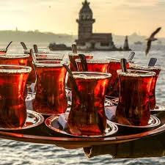

Subtlety of gifts
Notes:
Compare this to the Turkish carpet sellers who offer much tea, a chair and ‘friendship’ or hospitality. Hard to leave without buying anything

Slide 30
Scenarios in modern publishing for industry to exploit
 | Real journal | Fake journal
Real paper | Science | Tricked scientist
Fake paper | Sokal affair-type; LLM (AI) | Propaganda, stirring..
Notes:
Mixed types:
Fake or bought editors (moles) (in charge of special issues in which bought (fake) papers are then inserted as mainstream science), a kind of whitewashing or paper laundering
Papers partly written by LMMs
Buy papers via paper mills
Increase your output via author kartels
Buy citations by reviewer kartels (MDPI case 85 (partly AI generated) reviewer reports asking the addition of certain references

Slide 31

Counteracting Merchants of Doubt
Let’s do our science well
Open Scholarship / Science (CUDOS)
Write intelligibly
Educate journalists
Support critical journalism & sleuths!
Regulate wisely and enforce
Fines must hurt
Educate, educate, educate

Slide 32


Slide 33
Corporate strategy | Examples
1.1. Fund safe research | poor indoor air quality; vaccines for tooth decay
1.2. Covertly undertake or prevent risky research | chemical additives in cigarettes; addictiveness of nicotine in rats
1.3. Control the design & analysis of primary studies and evidence syntheses | cherry-picking papers
1.4. Shape and undermine external research | Get access to public research bodies; Fund grant-making bodies set up independently from industry, to shape research priorities; prevent funding of critical agencies (e.g. IARC)
1.5. Ensure favorable research is heavily represented in the evidence base | Fund existing journals or create your own; Repeatedly publish the same research; Use “ghost-writing” companies to produce large numbers of papers; Symposia proceedings, reports, abstracts
1.6. Control reporting & suppress publication of unfavorable science | Report selectively; employ lawyers to suggest edits to documents or removal of unfavorable sections; use sponsorship & ads as sticks rather than carrots
Notes:
1.1. refers to macro strategy 1 and meso strategy 1 etc. The examples are micro strategies (https://pubmed.ncbi.nlm.nih.gov/34161371/)
https://www.rivm.nl/nieuws/reactie-rivm-op-kritiek-mesdag-zuivelfonds
https://www.mesdag-fonds.nl/nieuws/143/-bug-in-rekenmodel-ops-oorzaak-onjuist-stikstofcijfer.html

Slide 34
Corporate strategies | Examples
2.1. Create alternative criteria for conduct & interpretation of science | Chemical Manufacturers Association’s “Guidelines for Good Epidemiology Practices”; Adopt the concepts of “junk science” and “sound science”; creation of front groups e.g. Advancement for Sound Science Coalition (TASSC)
2.2. Obtain and reanalyze raw data from unfavorable science | Data access litigation, litigate against scientists; Re-analyze (independent) data to refute unfavorable findings
2.3. Attack and misrepresent science | Label unfavorable science “junk”; Misrepresent single pieces of evidence or whole evidence bases; Citing own (non-peer-reviewed) science to refute unfavorable peer-reviewed evidence e.g. citing its own symposia proceedings
2.4. Monitor and attack scientists and organizations | Remove individual scientists from positions of power; Attack scientists or organizations to intimidate them, undermine their reputations and/or drain their resources; filing scientific misconduct complaints;
Notes:
https://www.rivm.nl/nieuws/reactie-rivm-op-kritiek-mesdag-zuivelfonds
https://www.mesdag-fonds.nl/nieuws/143/-bug-in-rekenmodel-ops-oorzaak-onjuist-stikstofcijfer.html

Slide 35
Corporate strategy | Examples
3.1. Use legal means to protect industry evidence from being discovered or accessed | Use code-word “zephyr” for cancer in internal memos about research; label scientific documents as “work product” or “privileged” to prevent them from being used in litigation; Silence plaintiffs using secret payments; Use ‘commercial in confidence' provisions to shelter CIC data from public review
3.2. Contract messengers to create scientific echo chambers | Create front groups to amplify industry-friendly scientific messages; Fund 3rd parties to amplify or shape their scientific stances; Build coalitions both within an industry, and with allied industries; Recruit, fund, and train individuals to be trusted scientific voices for industry
3.3. Fund, produce and disseminate materials which package science in industry-favorable ways | Fund, produce and disseminate lobbying materials; Fund, produce and disseminate textbooks, letters to the editor, practice guidelines, school materials; Obtain and disseminate reprints of industry-favourable scientific outputs
3.3. Use education, events, and meetings to disseminate industry-favorable scientific messages to key stakeholders | Infiltrate decision-making contexts to ensure industry-friendly scientific stances are heard; pharmaceutical industry sponsoring continuing medical education (CME);
3.4. Maximise press coverage of industry-favorable scientific messages | Co-opt journalists through media training and conference funding; demanding equal time for both sides of the “debate”; promote favorable research that has not been disseminated via scientific channels
Notes:
1.1. refers to macro strategy 1 and meso strategy 1 etc. The examples are micro strategies (https://pubmed.ncbi.nlm.nih.gov/34161371/)
https://www.rivm.nl/nieuws/reactie-rivm-op-kritiek-mesdag-zuivelfonds
https://www.mesdag-fonds.nl/nieuws/143/-bug-in-rekenmodel-ops-oorzaak-onjuist-stikstofcijfer.html

Slide 36
Corporate strategy | Examples
4.1. Implement and utilise industry-friendly standards of evidence in regulatory decision-making | Utilise such standards in attempts to undermine the use of unfavorable science in regulatory decision-making ; Lower stricter standards to softer levels and call it “harmonization” Brussels Declaration Sound Science Good Epidemiologic Practice (GEP) Science Based Targets initiative (SBTi)
4.2. Secure and utilise policymaking reforms which increase reliance on and provide a conduit for industry-favorable evidence | Mandate the use of business impact assessment using a Cost Benefit Analysis; Overplay potential job losses; Lobby for mandatory stakeholder consultation; Secure reductions in evidence requirements for some regulatory decision-making; Use trade and investment treaties to reduce safety thresholds
Notes:
1.1. refers to macro strategy 1 and meso strategy 1 etc. The examples are micro strategies (https://pubmed.ncbi.nlm.nih.gov/34161371/)
https://www.rivm.nl/nieuws/reactie-rivm-op-kritiek-mesdag-zuivelfonds
https://www.mesdag-fonds.nl/nieuws/143/-bug-in-rekenmodel-ops-oorzaak-onjuist-stikstofcijfer.html

